Slide 1
Course Name: Database Systems Course Code: CS52 Credits: 3:1:0 UNIT 5 Tutorial Term: September – December 2020
M.S. Ramaiah Institute of Technology
(Autonomous Institute, Affiliated to VTU)
Department of Computer Science and Engineering
Faculty:
Sini Anna Alex

Slide 2
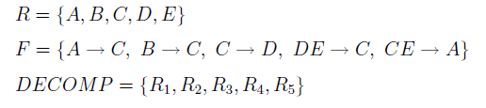
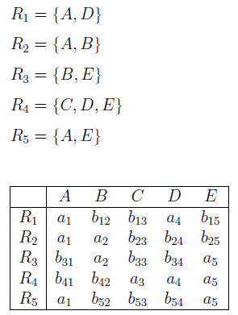
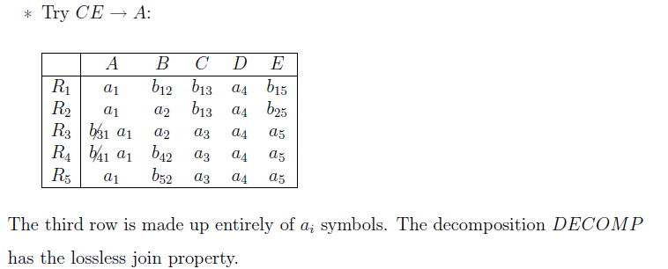
Test for Lossless(non additive) join property

Slide 3
Find a dependency-preserving decomposition
DECOMP = {R1, R2, . . . , Rn} of R such that each Ri in DECOMP is in 3NF
R = {A, B, C, D, E, H},
F = {AE → BC, B → AD, CD → E, E → CD, A → E}

Slide 4
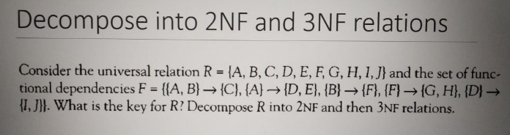
And also Test for non additive join property

Slide 5
Consider a relation R(A, B, C, D, E) with the following dependencies: AB -> C, CB -> E, E ->DA. Find the key
AB+=ABCED
BC+=BCEDA
E+=EDA
AB is the primary Key
BC is the candidate key

Slide 6
Check for Non-additive Lossless-Join Decomposition
R1= ABC and R2= BCD, with
F = {A→BC ,C →B, B →C, D →B}

Slide 7


Slide 8
Thank you

